Slide 1
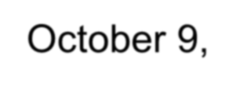
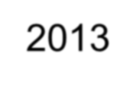
Kane County Surficial Geology Map 2013
New Countywide Map from the Illinois State Geological Survey
Presented to the Kane County Development Committee
Paul M. Schuch, P.E., Director
Water Resources Division
October 9, 2013

Slide 2
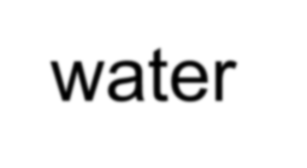
Kane County’s Planning and Resource Management Programs are built upon Regional and Statewide Land Resource Management Planning
In 1985 , Illinois adopted the Local Land Resource Management Planning Act, Illinois Compiled Statutes, Chapter 50 ILCS 805.
This important legislating added to the ability of counties and municipalities to develop joint land resource management plans that address critical land and water resource issues.

Slide 3
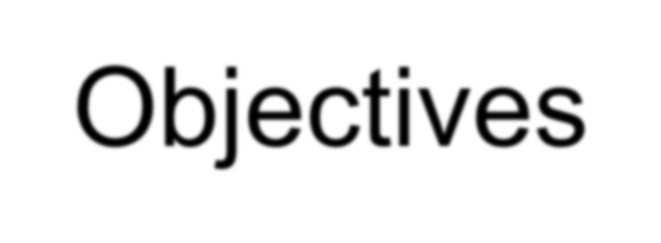
Kane County 2040 Plan Surficial Geology Related Objectives
Water Resources
Recognize that an integrated system of land and water resources is a major component of our built and natural Environment.
Promote Green Infrastructure best management practices and technologies to filter and capture stormwater runoff for improved water quality, groundwater recharge . . .
Green Infrastructure
Preserve and Protect Kane County open space and green infrastructure as the cornerstone of natural resource protection and community well-being.
Continue the efforts in protecting the environment and restoring the unique and fragile environments associated with the geography of Kane County.

Slide 4
Kane County 2040 Plan Surficial Geology Related Policies
Water Resources
Preserve and protect the quality of groundwater and surface water, the primary sources of drinking water in Kane County . . .
Cooperate with Forest Preserve, local government entities, park districts, and private landowners in the development of watershed preserves, conservation areas, greenways, reforestation programs, wetlands, and buffers . . .
Green Infrastructure
Encourage the coordinated implementation of the Forest Preserve District Master Plan, township, park district, and other open space plans.
Incorporate conservation and sustainability criteria in development controls and County ordinances to protect natural, scenic, historic, archaeological and environmental areas . . .

Slide 5
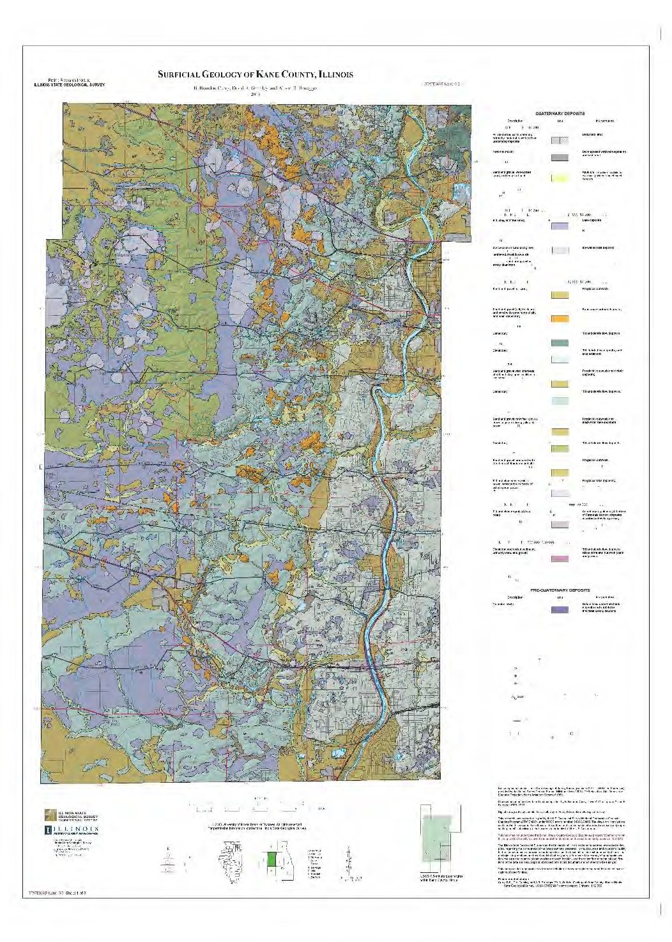
How is knowledge of Surficial Geology important to implementation of the Kane County 2040 Plan?
Surficial Geology of Kane County, Illinois
← ? →

Slide 6
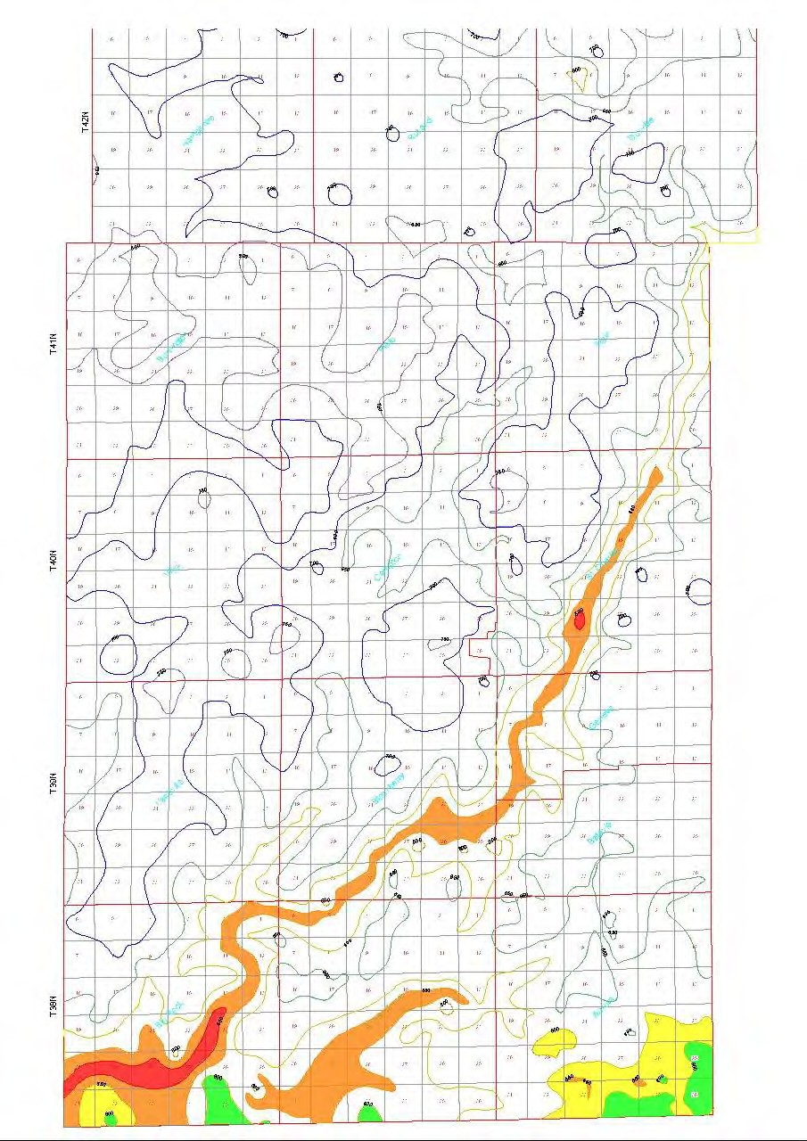
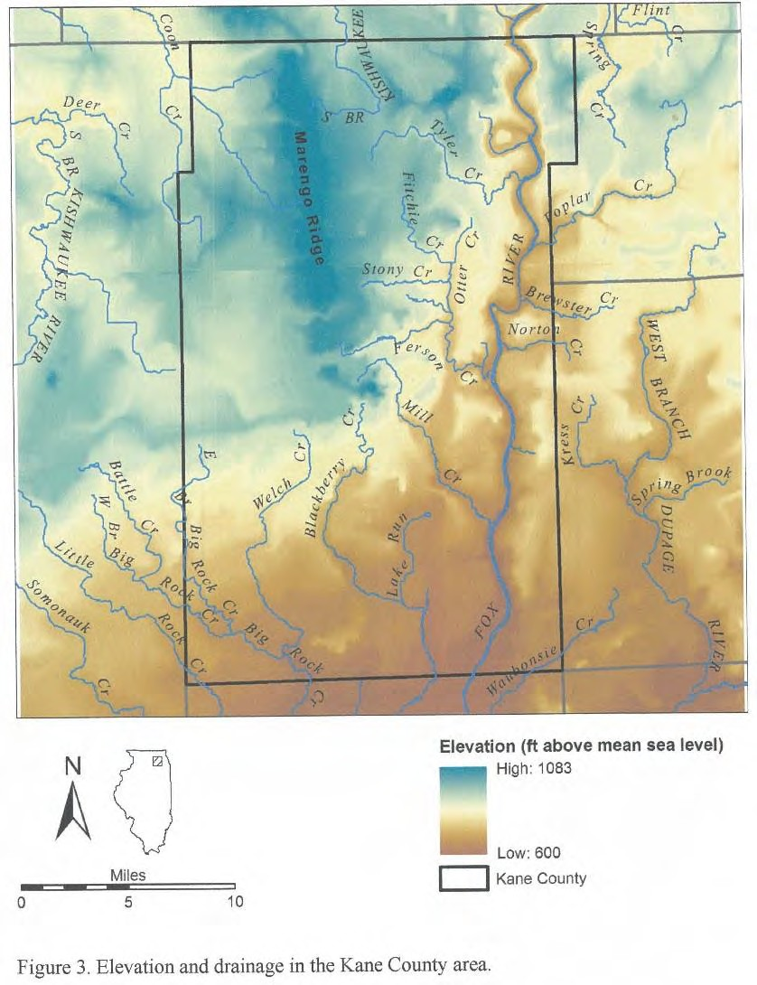
Surface Elevations and Drainage Map
Surficial soils are those that begin at the bedrock surface and end at the ground surface.
HIGH 700 +
HIGH
800+
LOW 600+/-
HIGH
1050+
Buried Bedrock Surface Topographical Map
LOW
~610
GREEN 600’ to 649’
YELLOW 550’ to 599’
ORANGE 500’ to 549’
RED 450’ to 499’
ELEVATION ABOVE SEA LEVEL
LOW 580+/-
LOW
<500

Slide 7
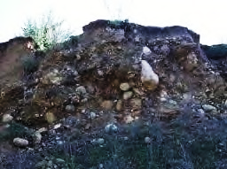
Soil Forming Factors
from USDA Natural Resource Conservation Service
Glacial Forces – Surging, Grinding, Retreating
Wind Blown Soils – Loess, Sand
River/Lake Sediments – Silts, sands, gravels
Plants, Animals, Micro-organisms, Humans
Temperature – Hot, Cold
Moisture – Wet, Dry
Steep Slopes – Wind and Water Erosion
Moderate to Flat Slopes – Deep Fertile Soils
Time – Recent to Long Term Features

Slide 8
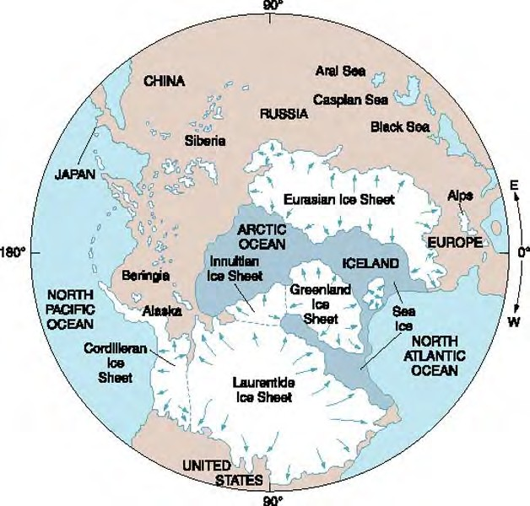
Global Polar Ice Sheets
(over the past 1,000,000 years or so)
Eurasian – Europe and Asia
Greenland
Innuitian – Northern Canada
Cordilleran – Western Canada and Southern Alaska
Laurentide – Canada and Northern U.S. (that’s us!)

Slide 9
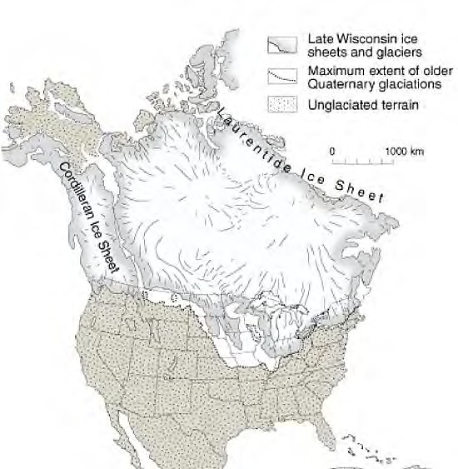
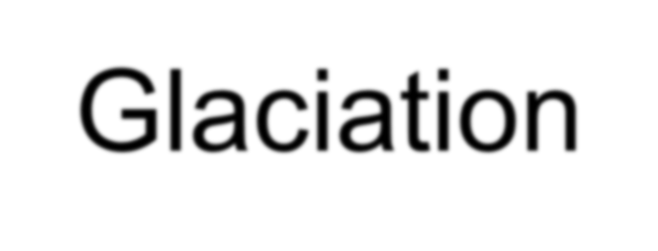
North American Glaciation
Nebraskan, Kansan, Illinoian Glaciations, with warmer interglacial periods between them, occurred from about 1,000,000 to
130,000 years ago.

Slide 10
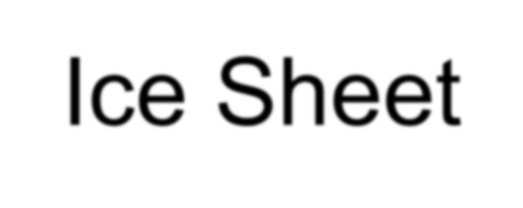
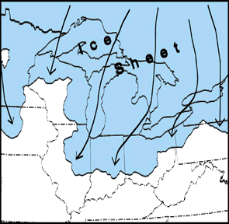
Wisconsin Ice Sheet
Then after another warm period from about 125,000 to 85,000 years ago the Wisconsin glaciation period began with its maximum advancement about 20,000 years ago.

Slide 11
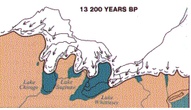
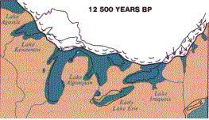
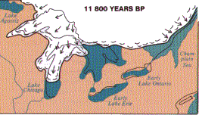
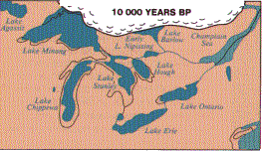
Glacial Advances and Recessions
BP = Before Present Time

Slide 12
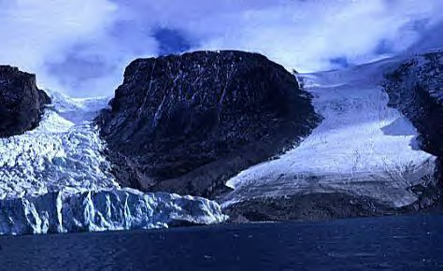
Glacier Terminology - Tidewater
Outlet glaciers, Royal Society Fiord, Northeast Baffin Island, Canada (You will see these today on an Alaskan cruise, but not in Kane County)

Slide 13
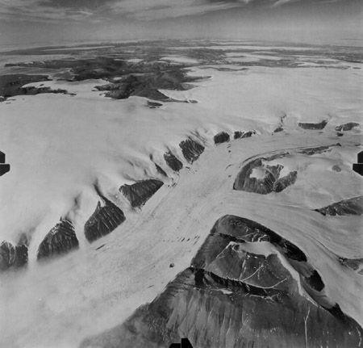
Glacier Terminology - Icefield
Kalstenius Icefield, located on Ellesmere Island, Canada, shows vast stretches of ice.
The icefield produces multiple glaciers that flow into a larger valley glacier (like what is now Lake Michigan). —Royal Canadian Air Force photograph

Slide 14
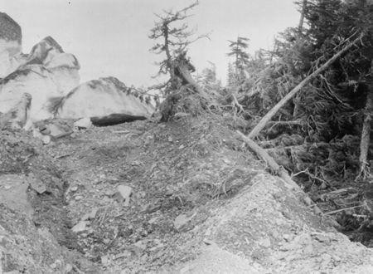
Glacier Terminology - Surging
Columbia Glacier in Alaska encroached on a forest as it surged in the early twentieth century, pushing trees, soil, rocks and debris as it advanced. This photograph was taken in 1914, several years after the glacier had begun to surge. Source: University of Colorado, Boulder

Slide 15
Glacier Terminology - Retreating
Muir Glacier, located in Glacier Bay, Alaska, photographed by W. Field in Aug. 1941 (left) and B. Molnia in Sep. 1976 (middle) and Aug. 2004 (right). Note how the glacier has retreated to expose rock in 1976 that has since become lush vegetation in 2004. The glacier has retreated so much that it is hardly visible in the 2004 photo. Courtesy NSIDC Glacier Photo Collection

Slide 16
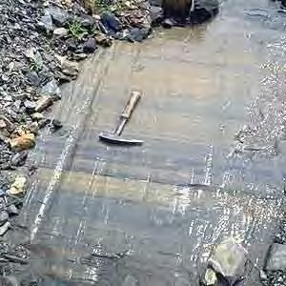
Glacier Terminology – Striations and Clasts
The fine features in this photograph are glacial striations, or glacial scratches, produced where clasts (gravel and rocks) carried by the glacial ice and meltwater cut into the bedrock. —Source: Natural Resources Canada

Slide 17
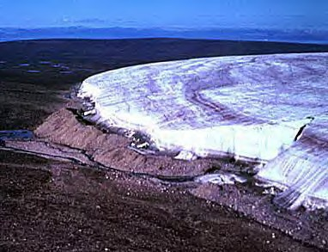
Glacier Terminology – End or Terminal Moraine
End moraine of a piedmont glacier, Bylot Island, Canada The sharp-crested ridge of till (end moraine) was pushed up at the ice margin during the glacier's maximum advance. — Source: Natural Resources Canada

Slide 18
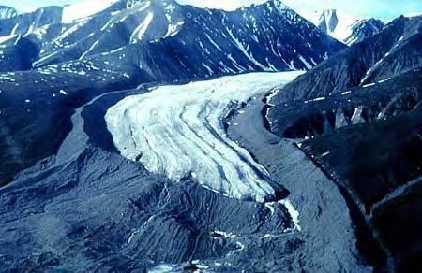
Glacier Terminology - Lateral or Edge Moraine
Lateral and terminal moraines of a valley glacier, Bylot Island, Canada. The glacier formed a massive sharp-crested lateral moraine at the maximum of its expansion during the Little Ice Age. The more rounded terminal moraine at the front consists of medial moraines that were created by the junction of tributary glaciers upstream. — Source: Natural Resources Canada

Slide 19
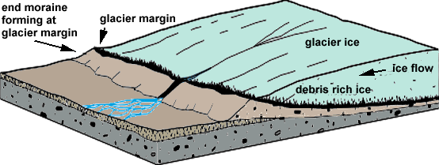
Moraine Deposits Typical to NE Illinois

Slide 20
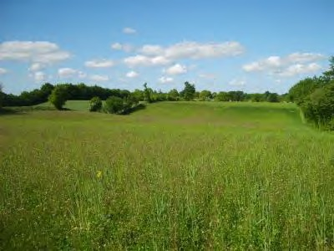
Glacier Terminology – Ground Moraine
Ground moraines are till covered areas with irregular topography and no ridges, often forming gently rolling hills or plains. It is accumulated at the base of the ice, but may also be deposited as the glacier retreats.

Slide 21
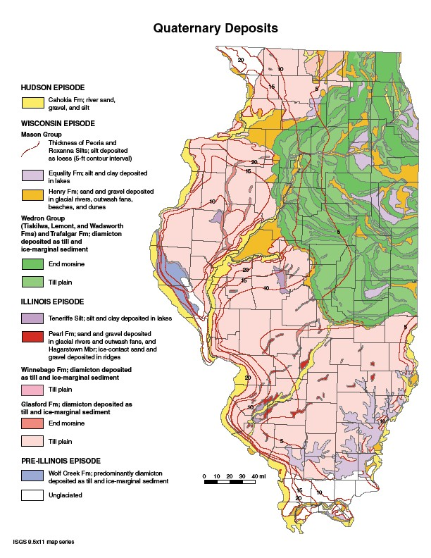
Illinois Glaciation Map
Two Main Episodes
Illinoian ~300,000—130,000 years ago (pink) in the U.S.
Wisconsin – 85,000 to 11,000 years ago in the U.S.
The most recent moraines were formed in Illinois 25,000 to 14,700 years ago
The most recent Glaciers receded out of Illinois about 13,500 years ago

Slide 22
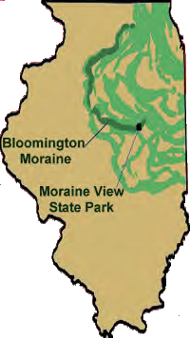
Terminal Moraines from the Wisconsin Episode Glaciation radiate from what is now Lake Michigan.
(Note the Bloomington moraine in this and the next slide.)

Slide 23
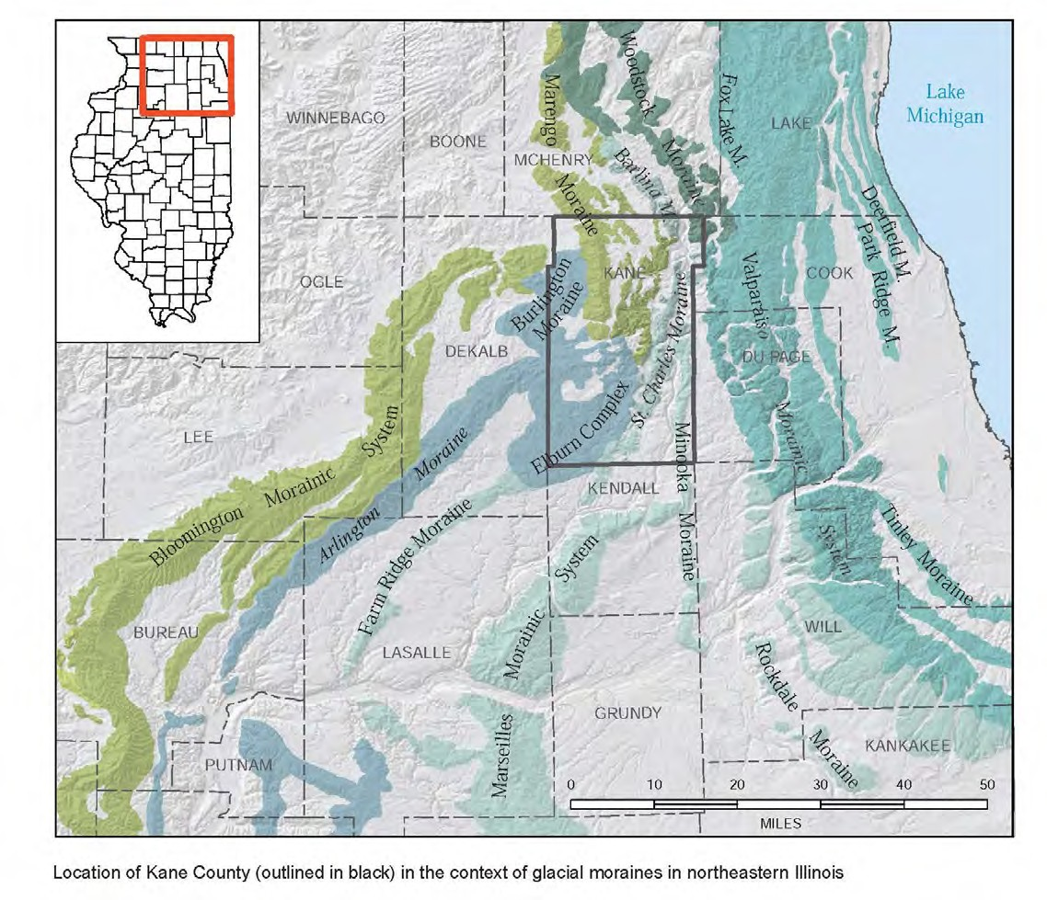
Illinois Glaciation Map
Location of Kane County in the context of Glacial Moraines in Northeastern Illinois showing major terminal moraines.

Slide 24
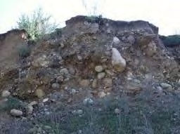
Glacial Till
Till is deposited by glacial ice either by being plastered onto the underlying glacial bed by flowing ice or by sloughing off the glacier's surface as the ice melts.

Slide 25
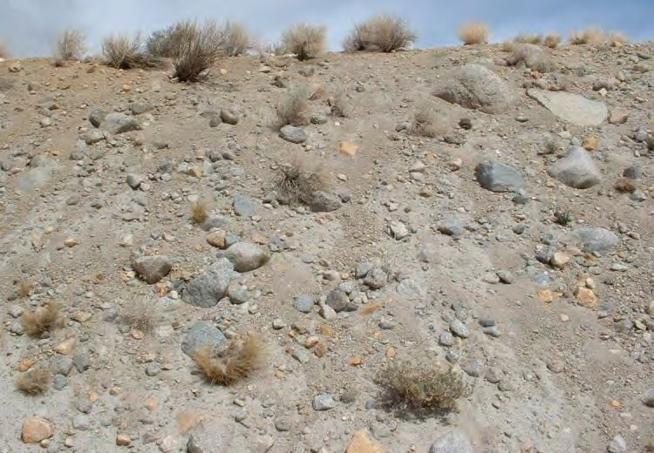
Glacial Till (continued)
Till is generally unstratified and commonly consist of large rock fragments surrounded by a finer grained matrix of sand, silt, and clay.
Glacial till differs from stratified drift because till is unsorted and has particles of many different sizes.

Slide 26
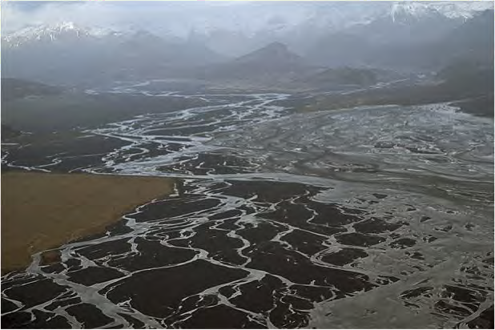
Glacial Outwash
Outwash is Sand and gravel deposited by glacial melt water. Outwash is typically well sorted and stratified so it differs sharply from tills, which are unsorted and unstratified.

Slide 27
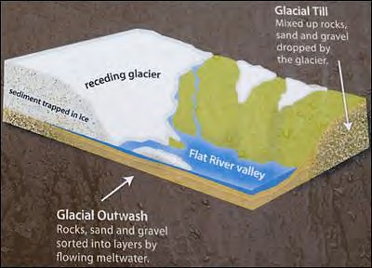
Glacial Outwash (continued)
An outwash may attain a thickness of over 300 feet at the edge of a glacier, although the thickness is usually much less.

Slide 28
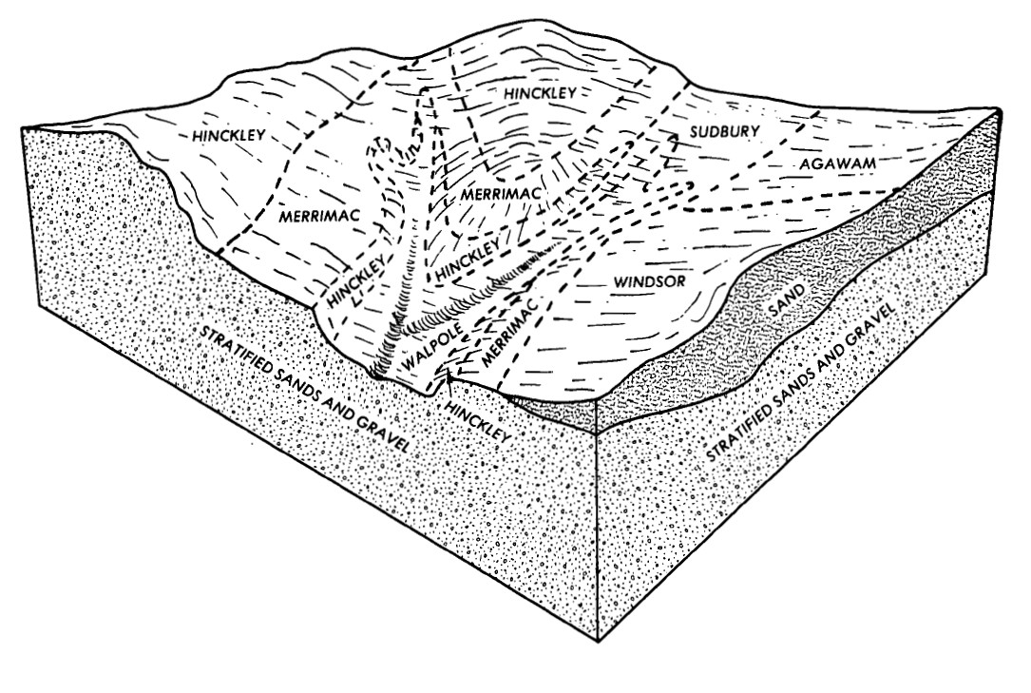
Glacial Outwash (continued)
The ordinarily gentle slope causes the larger material to be dropped nearest the glacier, while the smaller grain sizes are spread over greater distances.

Slide 29
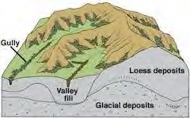
Loess and Glacial Deposits
Loess is principally wind deposited silt much of which was eroded from glacial sediments.

Slide 30
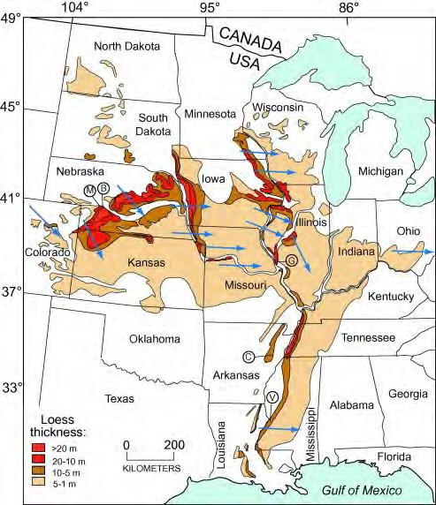
Loess Deposits
Vast accumulations are spread across the upper Midwest United States, with significant deposits along major rivers like the Mississippi.

Slide 31
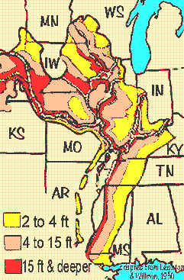
Loess Deposits
As glaciers advanced across North America they ground the underlying rock into a powder- like "glacial flour". This sediment was laid down by glacial melt water and later eroded from the dry deposit by strong wind.

Slide 32
Illinois Glaciation Map
What does the new Kane County Surficial Geology Map look like?

Slide 33
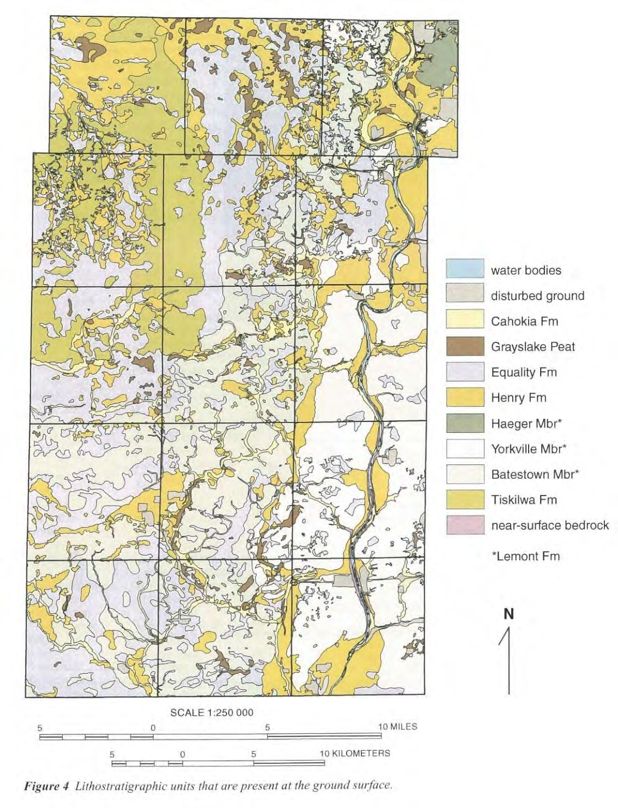
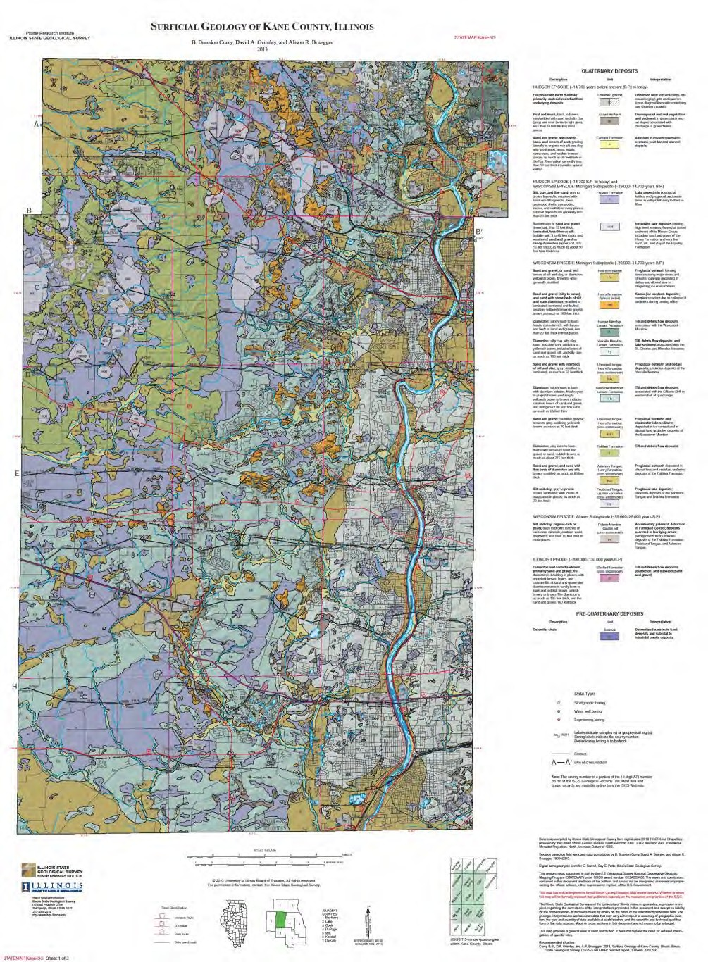
OLD 2007 MAP
NEW 2013 MAP

Slide 34
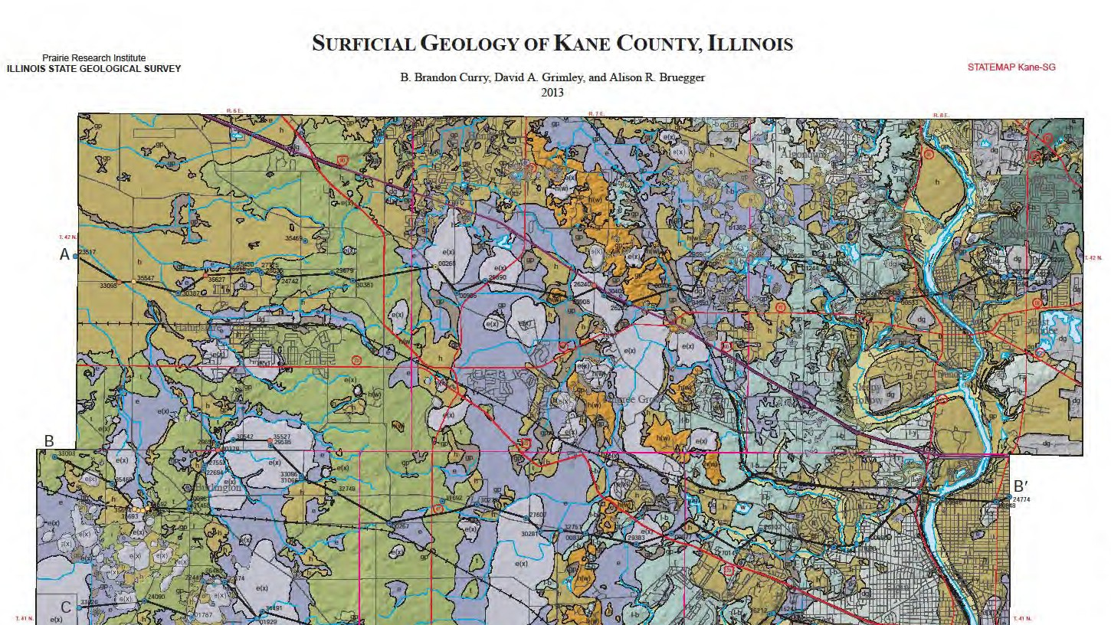
IL-72
B
RANDALL RD
B
47

Slide 35
LOOKING NORTH
Fox River Valley
B
Burlington Moraine
Marengo Moraine
B
Glacial Lake Pingree
Well or Boring Logs
Bedrock Surface
B
B

Slide 36
Go to WWW the Internet:
2013 Surficial Geology of Kane County, Illinois maps:
http://www.isgs.illinois.edu/sites/isgs/files/maps/county-maps/kane_sg_map.pdf
THREE-DIMENSIONAL GEOLOGIC MODEL KANE COUNTY, ILLINOIS – 2007:
http://www.idaillinois.org/cdm/ref/collection/edi/id/76455
For more Information and to learn more.

Slide 37
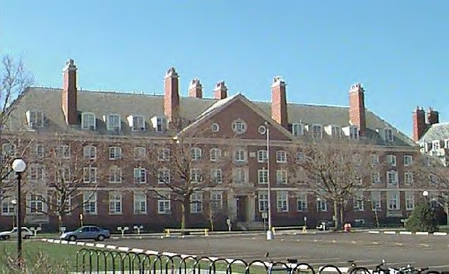
Illinois Geologic Map Advisory Committee
Annual Meeting - Thursday, September 12, 2013 - 10:00am to 3:00pm
The IGMAC meets annually in a forum to discuss geologic mapping needs and seek regional mapping coordination and opportunities. Its primary function is to review and approve long term plans by the ISGS for geologic mapping, as mandated by the Federal National Cooperative Geologic Mapping Program.

Slide 38
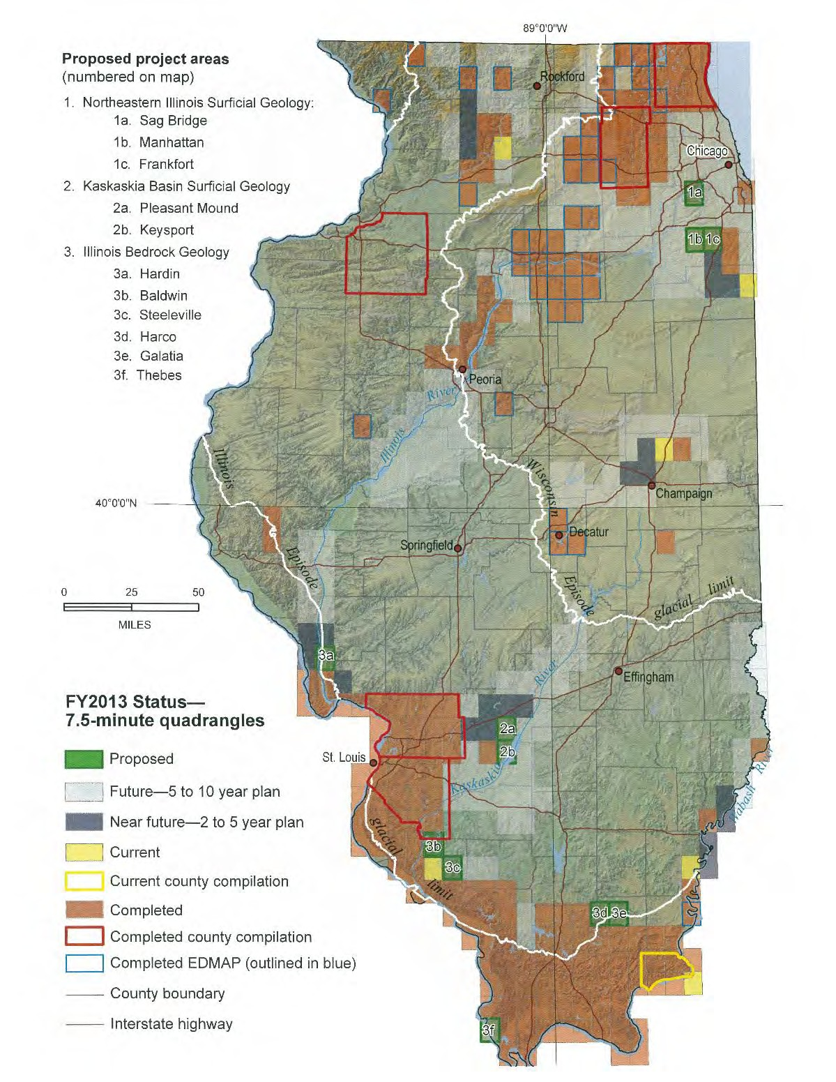
Illinois Geologic Map Advisory Committee
This review is necessary for the ISGS to participate in the USGS STATEMAP program, in which the objective is to establish the geologic framework of areas that are vital to the welfare of the United States. Also reviewed are mapping plans within the Great Lakes Geologic Mapping Coalition and other mapping initiatives in the state.

Slide 39
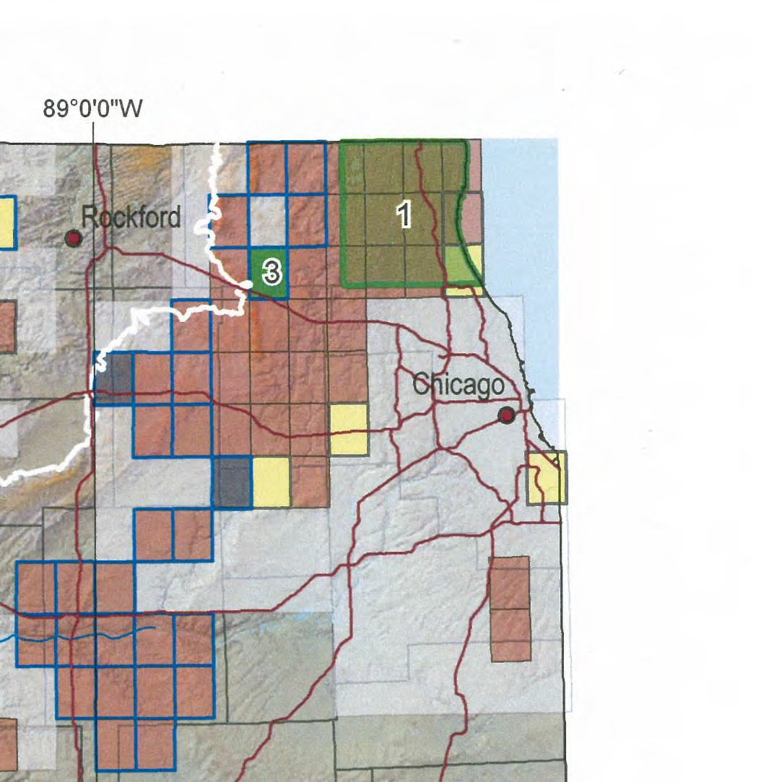
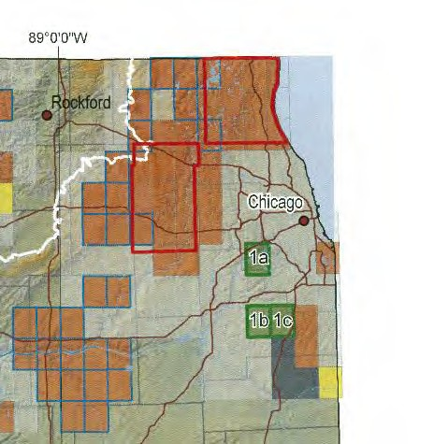
Illinois Geologic Map Advisory Committee
Kane County 2010 Program Status
Kane County 2013 Program Status
* * *
* * *
* * *
*
*9 USGS Quadrangle
*Kane Compilation
Maps Completed
Map Completed

Slide 40
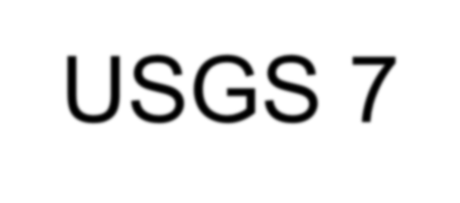
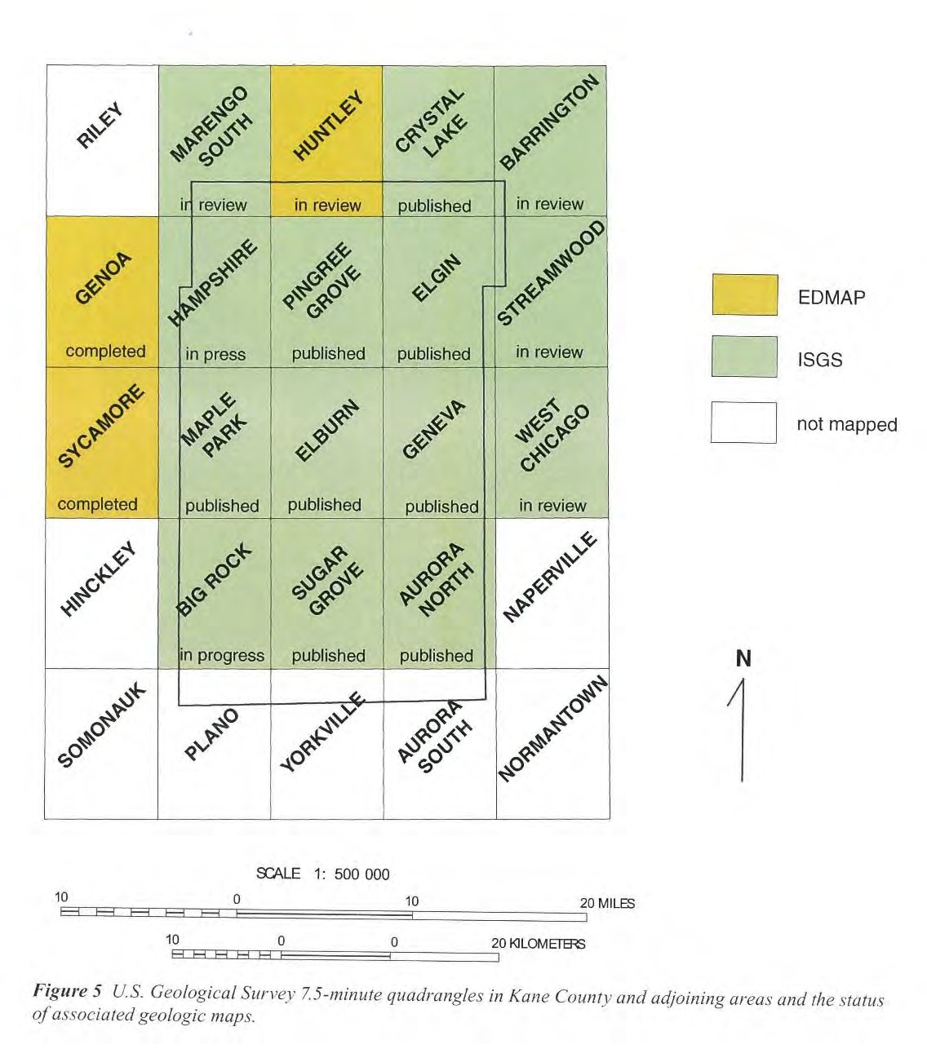
USGS 7-1/2 Minute Quadrangles
The ISGS mapped the surficial geology in the main 9 Kane County quadrangles first, one or two quadrangles at a time, in 1994, 1996, 1997, 1998, 2008 and
2011 using funds from the USGS STATEMAP program (see the symbols on the map). Other quadrangles on the county’s fringe were mapped under other funding
programs or as part of the neighboring counties’ geologic mapping programs. The 2013 Kane County Surficial Geology Compilation map was then compiled from the various USGS quadrangle maps.

Slide 41
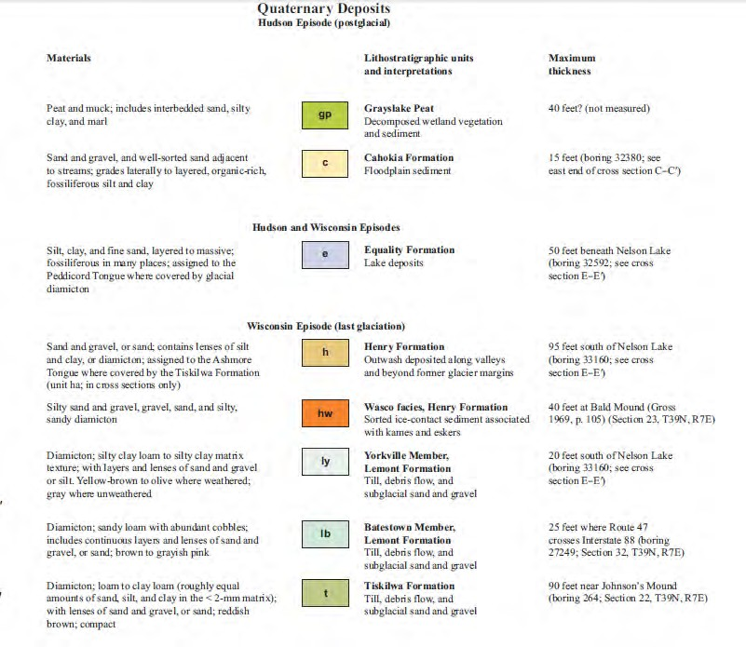
Sugar Grove Quadrangle Map
IL-47
MAIN ST
I-88
US-30
IL-47

Slide 42
Calculate the $ Value to Kane County
Neighboring County Quadrangles
Kane County Quadrangles

Slide 43
Pro-rate 10 maps out of 148 = (10/148) X $7.6 M = ~ $514,000

Slide 44
ISGS Comments
“The surficial geology of Kane County is very well understood in terms of material properties of geologic units, and their mapped extent (as shown on the maps and cross sections). Thanks to ongoing projects in the county, from early studies at Fermilab in the late 1960’s, subsurface investigations for the Superconducting Super Collider in the mid-to-late 1980’s, and the more recently completed groundbreaking (no pun intended) groundwater model, Kane County has always stayed on the “cutting edge” of environmental science. It would probably be accurate to say that the maturity of understanding is greatest here. . . Kane County outshines . . . other projects . . .” - Brandon Curry - ISGS

Slide 45
Surficial Geology Map - Possible Future Work in Kane County
Surficial Geology of Kane County, Illinois
A suite of north-south trending cross sections
Make the map “smart” and add links to key borings that would bring up the data consultants and environmental scientists use in their investigations
A sample of new borings in areas of interest

Slide 46
How is knowledge of Surficial Geology important to implementation of the Kane County 2040 Plan ?
The Wisconsin and earlier glaciations have left a complex of landforms, sediments and landscapes that set the framework for life and human activities in Kane County.
Healthy human societies rely on natural resources that are products of the glaciations, like sands and gravels for construction activities, groundwater supply in glacial outwash, and fertile glacial till and outwash planes for agriculture. . . .

Slide 47
How is knowledge of Surficial Geology important to implementation of the Kane County 2040 Plan?
(continued)
Healthy animal and plant communities also thrive on the native landscape and resources.
Our future water supplies and green infrastructure must be structured around our sustainable soil and water resources.
Detailed geologic knowledge, along with other scientific knowledge, leads us to the truth in how man must interact with nature in a sustainable fashion.

Slide 48
Thank you to the following:
Illinois State Geological Survey – Brandon Curry, Dave Grimley, Bill Dey, Alison Bruegger and their other Scientists
U.S. Geological Survey – STATEMAP AND EDMAP Programs
National Snow and Ice Data Center - Photos and narratives (see http://nsidc.org/cryosphere/glaciers/gallery/grooves.html)
Kane County former staff – Dick Young, Phil Bus, Jon Duerr for their pioneering work with the ISGS and others regarding the county’s natural resources.
Others cited on the individual slides in this presentation.

Slide 49
Thank You!
Paul M. Schuch, P.E.
Kane County Director Water Resources
schuchpaul@co.kane.il.us
www.co.kane.il.us

